Slide 1
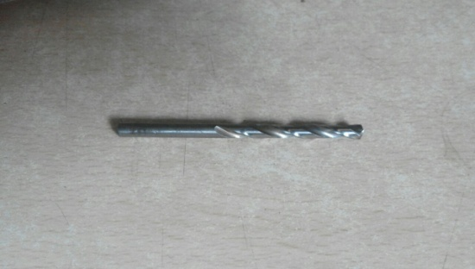

KAIZEN SHEET
Advik
TPM CIRCLE NO :-
ACTIVITY
KK
QM
PM
JH
SHE
OT
DM
E&T
TPM CIRCLE NAME :- QM
LOSS NO. / STEP
KAIZEN NO:-
CELL :- No 4
DEPT :- Aadesh
RESULT AREA
P
Q
DEF :- A / B / C
C
D
S
M
CELL NAME : CNC Line
MACHINE / STAGE :- Tapping Machine
OPERATION :- Tapping
KAIZEN THEME::- To Eliminate A238 Shaft
Thread Found Not Ok .
IDEA :- Kaizen Drill size change 5.0 mm against to 5.10 mm.
COUNTERMEASURE :- provide 5.0 mm drill
for drilling operation for miner id maintaining
4.95/5.00 mm
BENCHMARK
1
WIDELY/DEEPLY:-
TARGET
0
PROBLEM / PRESENT STATUS:- A 238 Shaft
Thread Found Not Ok .
KAIZEN START
08/ 12 /2016
KAIZEN FINISH
10/2/2017
Team Members :- Bharat , Sayyed.
Benefits:- Prevent re-occurrence of customer complaint, Eliminate in-house rejection ,Mistake proof process generated .
5.10 mm
5.00 mm
KAIZEN SUSTENANCE
BEFORE
AFTER
WHAT TO DO :- PFD , PFMEA CP
To be updated check point added in
Inspection check sheet and PDIR
WHY-WHY ANALYSIS :-
RESULT :-
Why1-A 238 Shaft Thread Found not Ok.
Why2-Miner diameter o/s.
Why3- Cnc operation use 5.10 drill for drilling operation.
HOW TO DO :- Process audit
FREQUENCY :- As per plan
COST INCURRED FOR MAKING KAIZEN
ROOT CAUSE :- Due to Blind Hole Tap Not
inserting completely When Tapping Rework
Process.
MATERIAL COST
RS.
LABOUR COST
RS.
TOTAL COST
RS.
REGISTRATION NO&DATE: 08/12/2016
SCOPE & PLAN FOR HORIZONTAL DEPLOYMENT
SR.
NO.
CELL
TARGET
RESPONSIBILITY
STATUS
REGISTERED BY :- Bharat k.
A238
Shaft
09/12/2016
BK
completed
MANAGER’S SIGN :-

